Slide 1
Image Annotation Research Paper Review
Md Sehebub Zaman Pranta (1611251042)
Tanvir Ahmed (1410982042)
Sadia Ahmed Tandra (1631474042)
Jannatul Ferdouse Onny (1631561042)
Rokeya Akanda Sriti (1620165042)
CSE499A.10

Slide 2
A Quadtree Image Segmentation G.R. Márquez, Hugo Jair Escalante, Luis Sucar
The proposed method is able to efﬁciently divide the image in homogeneous segments by merging adjacent regions using border and color information.
This method is highly efficient and provides segmentations of acceptable performance used for automatic image annotation and related tasks like object recognition.
The main objective is to offer a tradeoff between efficiency and segmentation that aims at give support to automatic image annotation and content-based image retrieval (CBIR).

Slide 3
A Quadtree Image Segmentation (Cont.)
This technique follows some guidelines like:
Recursively divide the image using a quadtree approach.
Merge homogeneous and similar quadtrees’ regions based on borders and color information.
Process and discard large image regions as fast as possible
Prefer detection of large objects.
Avoid noise in result segments and provide any-time segmentation.

Slide 4
A Quadtree Image Segmentation (Cont.)
Dividing the segmentation process in ﬁve steps:
(1) Edge detection,
(2) Border processing,
(3) Color discretization,
(4) Quadtree scanning and
(5) Segmentation enhancement.
Although our formulation is intended for automatic image
annotation usage, it can be used for other tasks that require
a fast segmentation implementation.

Slide 5
How It Works
Minimum Object Size
Image
(1)Border Detection
(2)Border Selection
(3)Color
Discretization
(4)QuadTree Segmentation
Minimum quad Size
Homogeneity threshold
(5)Segmentation Enhancement
Segmentation
Result

Slide 6
Time Complexity
For each step the complexity are following:
(1) Border detection: 7×N;
(2) Border selection: 4N
(3) Color discretization: N
(4) QuadTree scanning: 2^{log}₄^{(N-1)}6N+C ; with C the number of operations required to divide a quadtree
(5) Segmentation enhancement: 2K+K²+N; with K the number of segments found.

Slide 7
The Goal Of This Experiment
To evaluate the segmentation performance of the proposed method where
First one consists of 18 heterogeneous manually selected images;
Second one consists of 100 randomly selected images from the Berkeley Segmentation Dataset
Third dataset consists of 14 images randomly selected from “Image of the Day” Wikipedia section

Slide 8
The Goal Of This Experiment (Cont.)
To evaluate the performance of an annotation method with segments generated with our segmentation technique in terms of segmentation and annotation accuracy
The annotation performance was evaluated with a dataset consisting of 500 images taken from the SAIAPR TC-12 , which is a benchmark of manually segmented and annotated images.

Slide 9
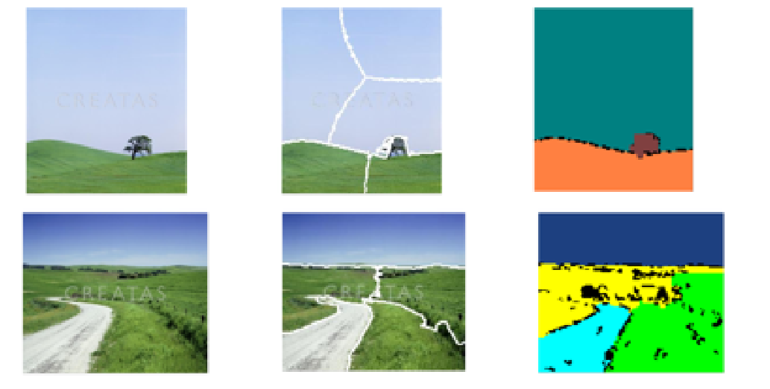
The Look Of Quadtree Image Segmentation

Slide 10
Result
This method is more accurate than those generated with normalized cuts. It is common for normalized cut stop partition regions that belong to the same object in more than a single region
But here in this method, it correctly identifies homogeneous segments. Here noted that was stated above, segmentation is a highly subjective process, hence evaluating the quality of segmentations produced with different methods is a subjective task as well.

Slide 11
Conclusion
This is a simple and efficient method for image segmentation, which resulted very helpful for image annotation, as evidenced by experimental results. This is specially true for images with big objects and simple textures.
The any time segmentation feature of our proposal in combination with its order of complexity makes it attractive to be used in time restricted environments

